Slide 1
part 1
lab session
Functions

Slide 2
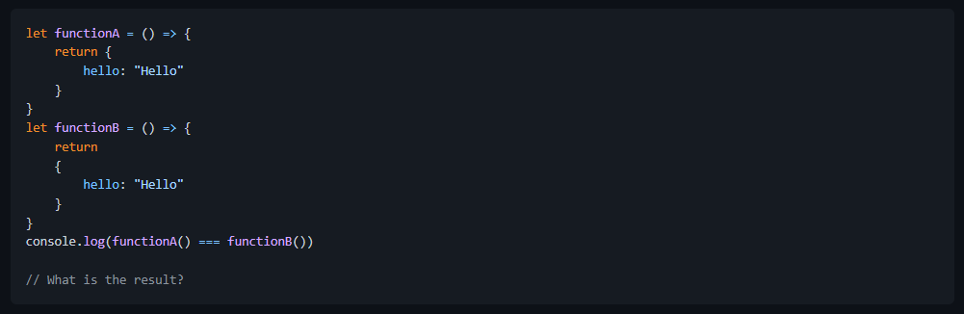
Lab 6a: Wrong insertion problem
Create 6a-wrong-insertion.js
What is the result?

Slide 3
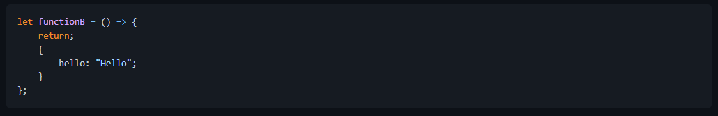
Lab 6a: Wrong insertion problem
Answer:
The above expression will return false. This is the compiler interpreted the line ending with return keyword from functionB as the end of expression and implicitly inserted the semi-colon to the wrong place. This effectively becomes.
functionB returns null and therefore is not equal to the result of functionA

Slide 4
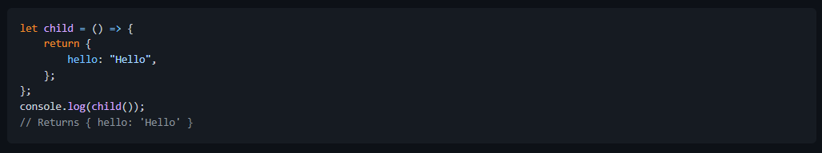
Lab 6a: Wrong insertion problem
Always begin a return block after the return keyword
For this to work, the { should be added immediately after the return keyword so that the compiler does not interpret the line as the end of expression.

Slide 5
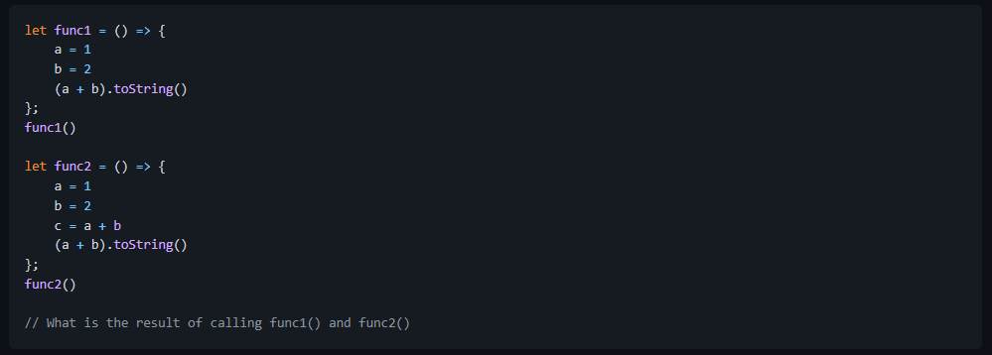
Lab 6b: Wrong omission problem
Create 6b-wrong-omission.js
What is the result?

Slide 6
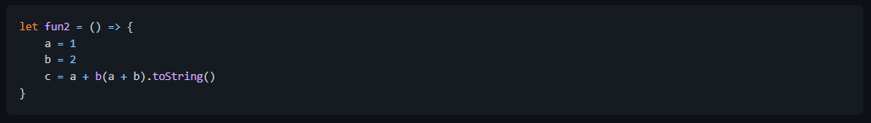
Lab 6b: Wrong omission problem
Answer
This is the opposite of the earlier problem. In this case, semi-colon was not inserted to the end of c = a + b because the compiler interprets the line (a + b).toString() as a continuation of the earlier line. Effectively, the code became:
The compiler then interprets b as a function of a + b, hence the error b is not a function is thrown.

Slide 7
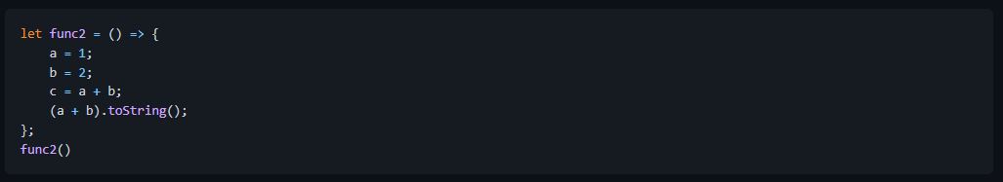
Lab 6b: Wrong omission problem
Always terminate expression with ;
You should always terminate expressions explicitly using semi-colon ; especially for functions.

